Slide 1
MTSS-B Small Group Counseling
Details
Once a week for 10 weeks
Small groups using CASEL-based curriculum​
Students become aware of feelings and emotions
Student develop positive coping strategies
Deeper understanding of the school-wide expectations
Build positive relationship with peers and staff
Small group counseling provides a safe setting where children, along with their peers, can develop and improve their tools in: Self Awareness, Self-Management, Responsible Decision-Making, Relationship Skills and Social Awareness
Notes:
Intervention Details
Grades Kinder-6th (Kinder referrals starting 1/2022)​
Small groups using CASEL-based curriculum​
10-week intervention​
Use At-Risk Screener form to nominate students​
Use teacher progress monitoring to assess student progress during intervention

Slide 2
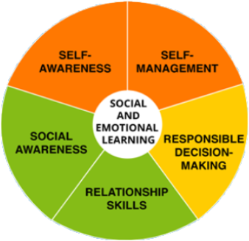
PBIS alignment to CASEL wheel
The goal is for students to walk away from K-12 schools with: Self-Awareness, Self-Management, Responsible Decision-Making, Relationship Skills and Social Awareness
HOW? Through MTSS
PBIS is the framework within MTSS that focuses on explicit behavior instruction through a systematic approach
Tier 1- anchored in expectations
Tier 2- anchored in data-driven interventions
Tier 3- anchored in individual student needs
Notes:
This school year we will be lining up our intervention and curriculum to the 5 competencies in CASEL. Students will still be identified and taught skills that support each school’s expectations but more explicitly through the CASEL Wheel.
Second Step is also aligned to these competencies so we will also take steps to align our curriculum and group topics to them. You’ll see these referred to in Tier 2 and Tier 3 goals. We will be communicating the group topics and lessons.
The 5 Competencies Anchor our Behavior Support- how explicit we get depends on the Tier that the student participates in.
Through Tier 1- we teach the 5 competencies through SW Expectations
Through Tier 2- we teach specific skills from these areas to a general group (geared towards a group goal & maybe delivered individually but focused towards a group)
Through Tier 3- we teach and support specific skills specifically tailored to an individual need

